Slide 1


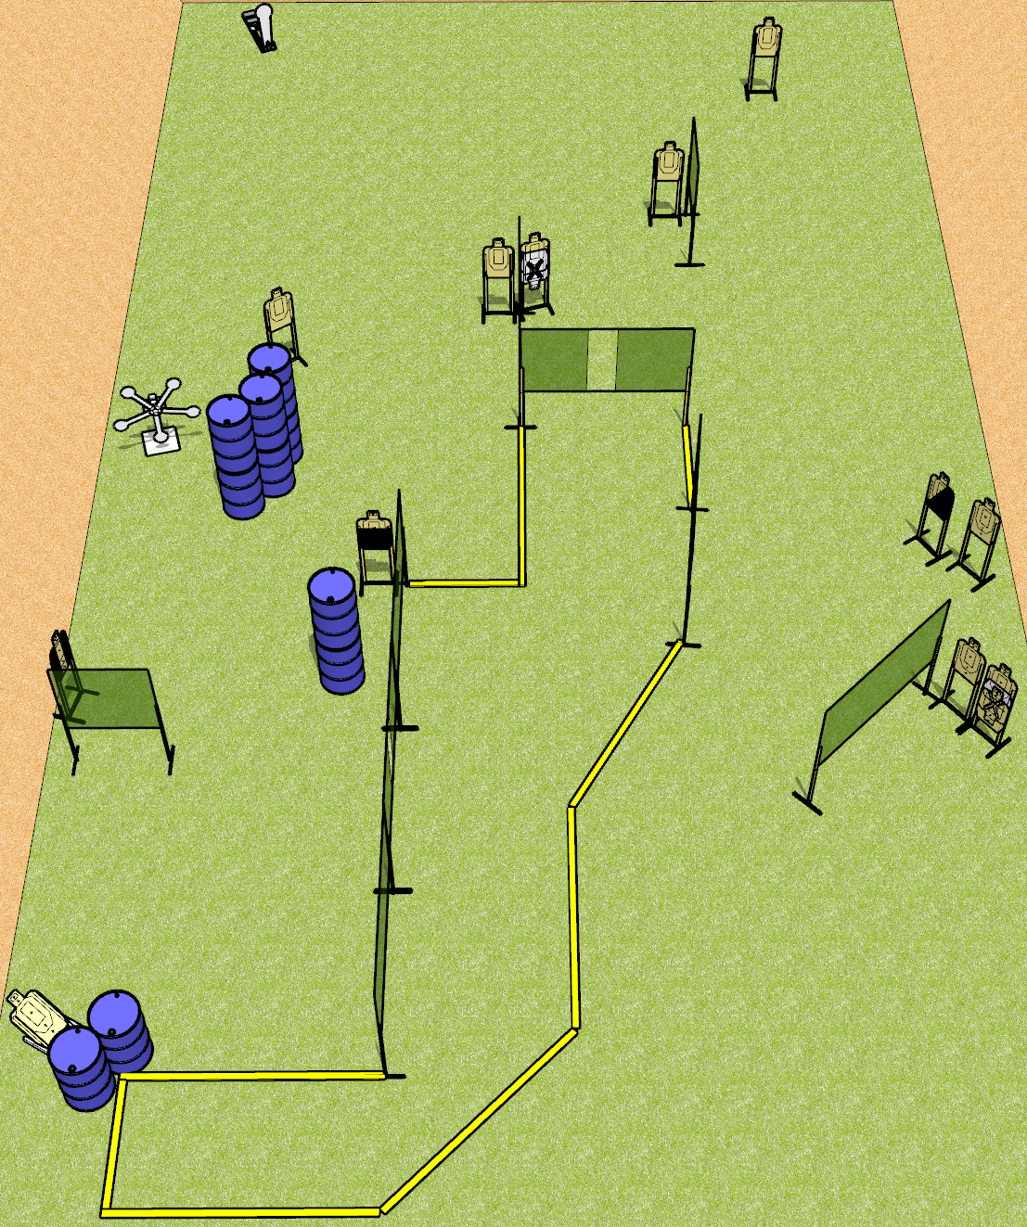
 | Dothan Gun Club – USPSA Match Tricky Dicky Course Designer : Drew Coleman
Round Count 32 rounds 13 USPSA 5 plates, 1 colt popper
Equipment List 15 wall feet Star 1 tux, 1 50%, 1 diag, 12 targets (10 + 2 NS)

Slide 2
Tricky Dicky
Written Stage Briefing
Tricky Dicky is a 32 round, 160-point, Comstock course of fire. There are 13 USPSA targets and 6 steel. The best 2 hits on cardboard will score, and steel must fall to score. The start signal is audible.
Handgun start position is anywhere inside the shooting area, wrists below belt. Handgun is loaded and holstered.
PCC start position is anywhere inside the shooting area, stock on belt. Loaded carbine is held with both hands, safety on.
On the audible start signal, engage targets as they become available from within the shooting area.

